Slide 1
Group for Earth Observation Presentation
Nicholas Coyne

Slide 2
Dissemination Team
Working at EUMETSAT since 1998 in the dissemination team
The Operations Dissemination team consists of 8 people
At the start of EUMETCast there where just 3
Supported by additional maintenance personnel
Supported by User Service
Notes:
Knew everyone in EUMETSAT at the beginning. Very small Operations team

Slide 3
Presentation Contents
Brief History of EUMETCast
EUMETCast Operations
Future
Sentinel 3
Ca. 30 minutes
Notes:
This is an outline of what I intend to present 44 slides. Not numbered. No chance to sleep

Slide 4
EUMETCast Origins
First used in 2002 in support of EARS
256 kb/s
MTP rapid scanning
Used for MSG due to MSG1 transponder failure.
Bandwidth increased to 2 Mb/s
Notes:
Beginning of EUMETCast

Slide 5
EUMETCast MSG Initial operations
Engineers had to make manual configuration using vi editor
Some automation scripts developed due to the exact change order
Rollout of EUMETCast Administration Tool (EAT)V1 2003 along with the operational start of MSG dissemination
Management of users and service directories
Controlled the change order constraints
Activities still performed as engineering tasks
Notes:
Initial EUMETCast operations were very tricky. One syntax error and everything stopped working. EAT was developed to resolve these issues

Slide 6
EUMETCast EAT Evolution
Service directory configuration
Service directory priority
Service directory channel assignment
Some Channel configuration
Min bandwidth
Max bandwidth
To list a few

Slide 7
Control of Users
EAT Updated to allow User Service to directly manage the user configuration (Version 3 2009)
No longer needed an engineer to perform the changes
Allowed different user groups access to the database. Their permissions could be tailored to allow control of different aspects
It also allowed external partners user control
Notes:
Retim. Guest. Removed a large work load from the engineers. Today the User Service team add the new users and edit the existing users settings taken from the EOP. The dissemaintion analyst makes these changes active.

Slide 8
Latest Version of EAT V5 (November 2015)
Allows management of multiple services, e.g. basic, high volume and terrestrial services
Controls the regular expressions for product routing
In house java development
Better visibility of dissemination configuration
Easier to change product routing to different channels and service directories
Less software to maintain
Notes:
Version 5 will greatly improve our control and visibility of the dissemination configuration. Developed in house.

Slide 9
Latest Version of EAT V5
User interface for EAT version 5 showing Basic, High Volume and Terrestrial
Notes:
A separate area for each service

Slide 10
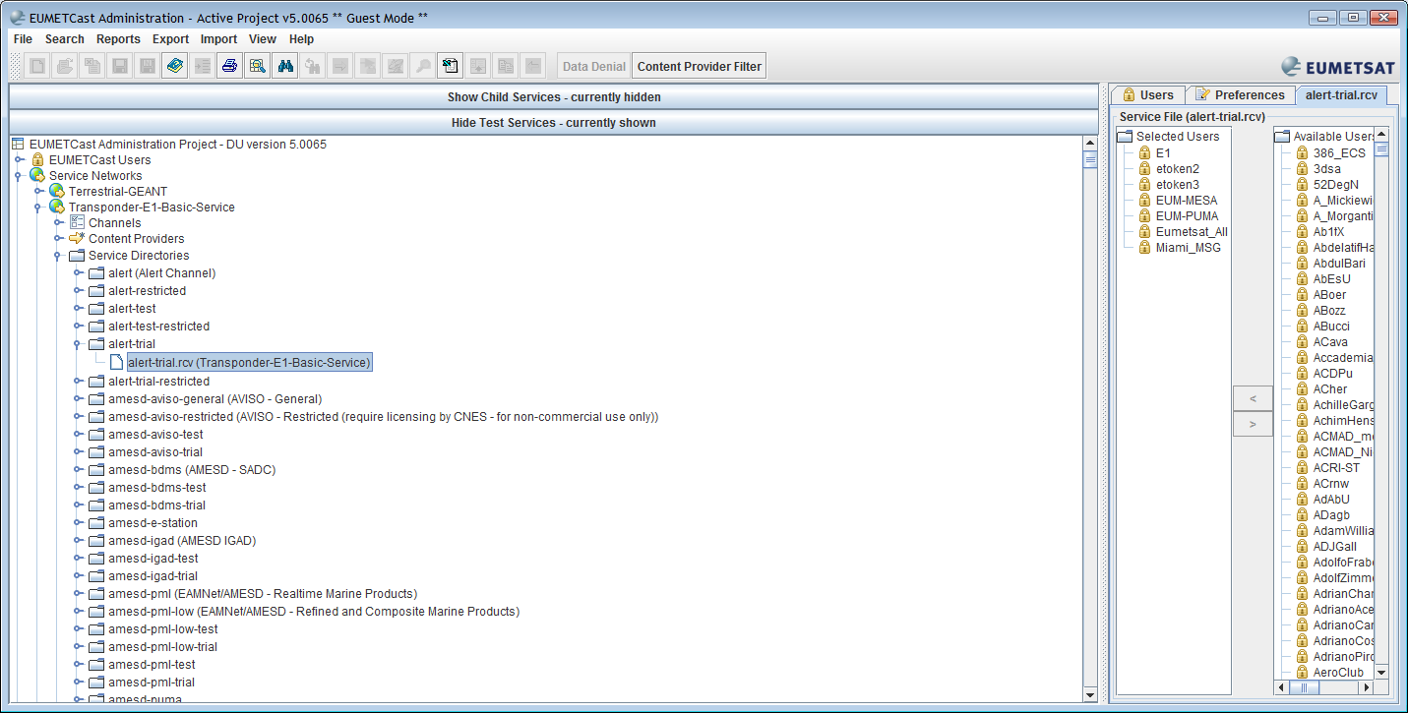
EAT Service Directories
Notes:
Shows how users are assigned to service directories

Slide 11
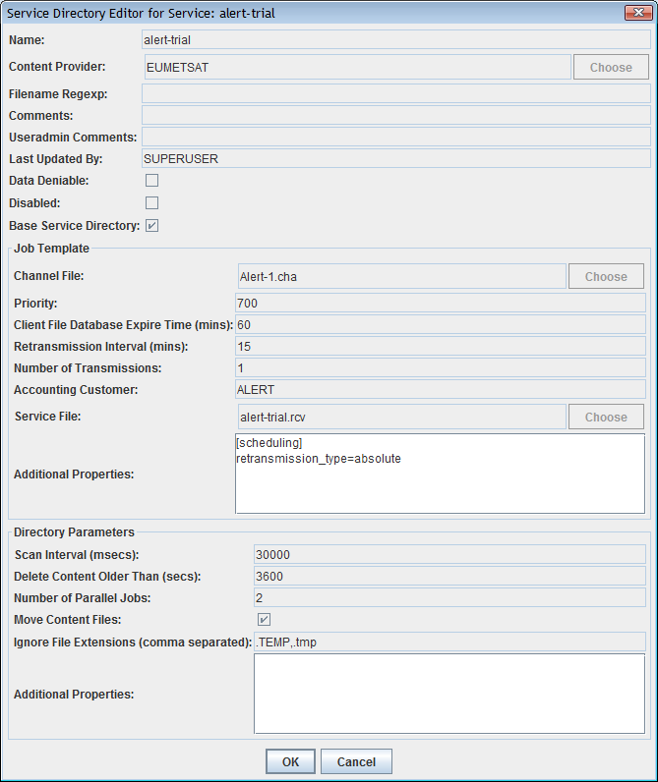
EAT Channel Selection
Notes:
Shows the parameters that are configurable from EAT for the channels

Slide 12
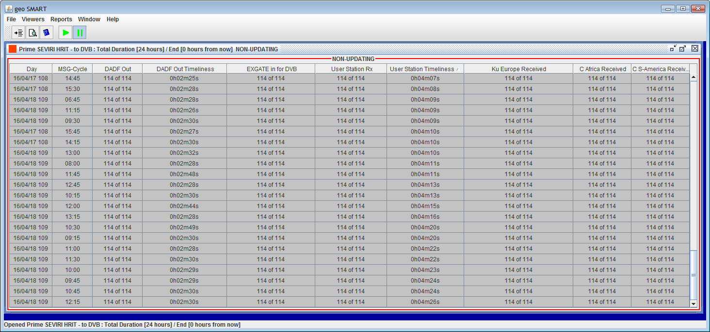
EUMETCast operations monitoring
Event driven near-real time monitoring
Utilises the receive logs from the stations
SMART - Service Monitoring and Reporting Tool
Notes:
SMART. Our main dissemination monitoring tool. We also have some check event agents. All the data that provides this information comes from our GEMS (Generic Event Monitoring System) We build lists of expected products and feed the messages from GEMS into these expectations. Any that are not met turn RED

Slide 13
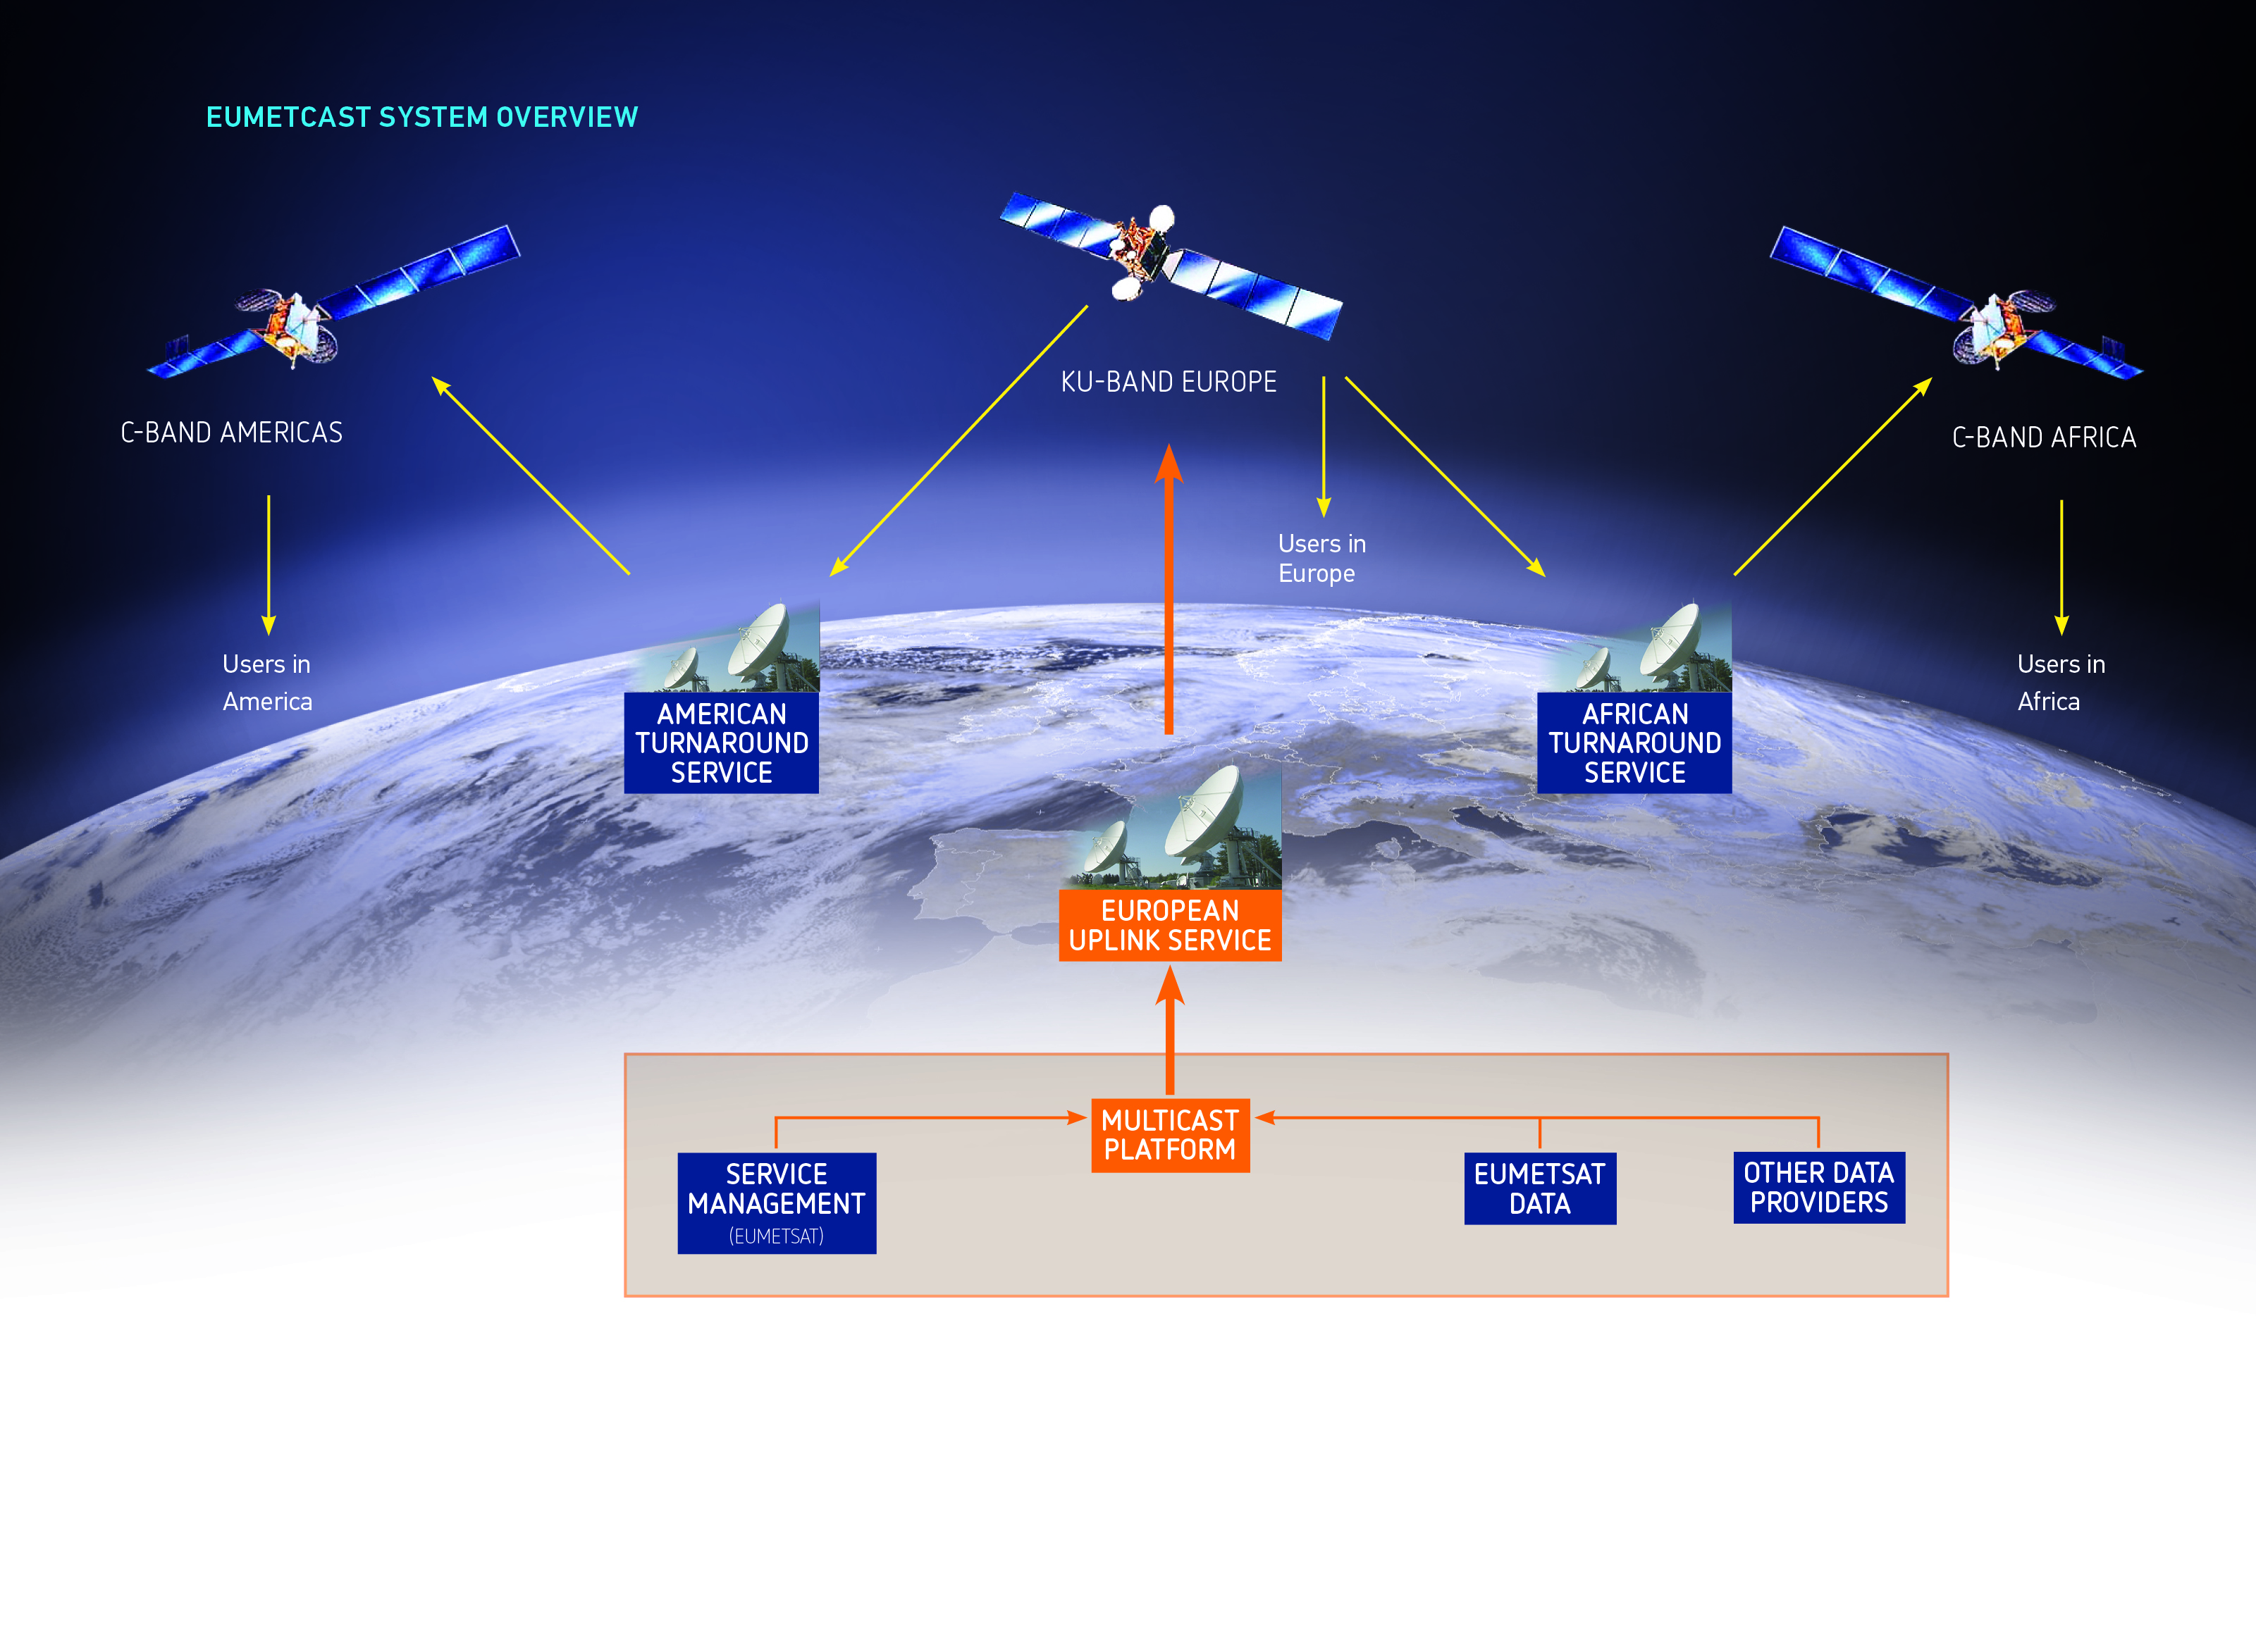
EUMETCast principles – Satellite
C-Band AMERICAS will stop by the end of 2016

Slide 14
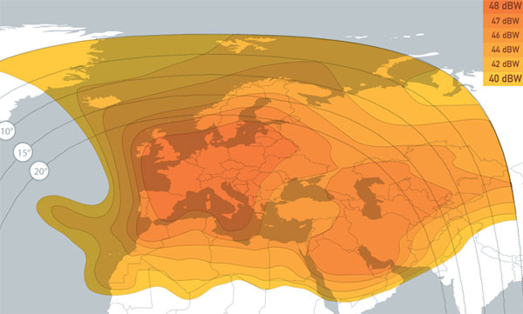
Overview - footprints
EUMETCast Europe
Eutelsat 10A
Ku-band
Position: 10° East
Launched: 2009

Slide 15
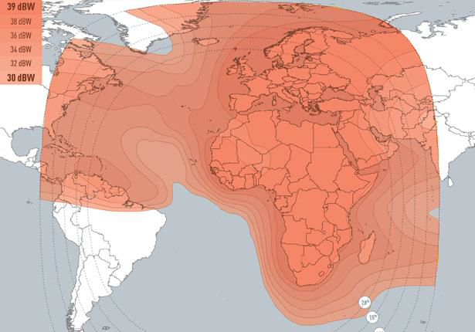
Overview - footprints
EUMETCast Africa
Eutelsat 5 West A (was AB-3)
C-band
Position: 5° West
Launched: 07/02

Slide 16
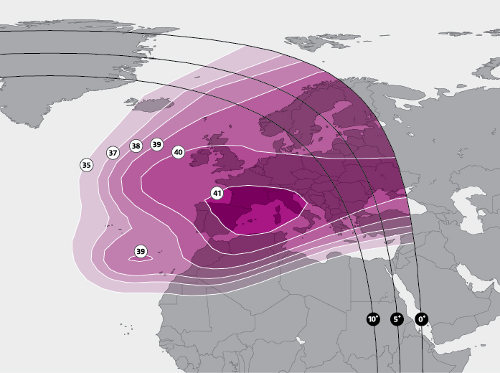
Overview - footprints
EUMETCast Americas
SES-6
C-band
Position: 40.5° West
Launched: 03/06/13
Notes:
Service will stop end of this year

Slide 17
EUMETCast Terrestrial
Network
High speed network for high volume data exchange
Scalability by overprovision of bandwidth
GEANT = backbone, funded by EU
No SLA
Access
Only “research” users, eligible organisations, etc. having access to NREN

Slide 18
EUMETCast principles – and Terrestrial
EUMETCast Terrestrial

Slide 19
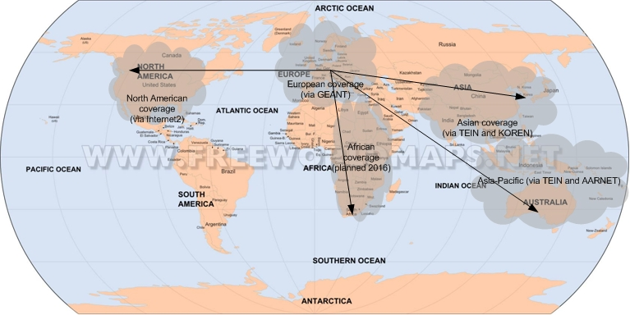
Overview of EUMETCast Terrestrial Demonstration Service
EUMETCast Terrestrial Demonstration service disseminates near real time environmental data based upon a multicast client/server system with the server side implemented at EUMETSAT and the client side in geographical dispersed locations. This is at current only a best-effort service with an intentional limited number of users.
Notes:
access restrictions for users to GEANT/NRENs. 5 main areas so far

Slide 20
EUMETCast design
Generic server/client file transfer system in “Push” mode;
From one server to (unlimited number of) many clients;
COTS “Tellicast” software using protocol based on IP multicast;
Use of commercial telecommunication satellites;
Use of multicast capable terrestrial network;
Robustness through forward error correction and retransmission, with and without return link;
High bandwidth efficiency;
Built for high availability systems;
Highly secure due to built in encryption

Slide 21
EUMETCast service control
At server side
Full bandwidth control and guaranteed timeliness of files;
Service directories allow access unlimited number of users at the desired granularity;
Data protection through encryption and physical (EKU) access control;
At client side
Allowing use of off-the shelf, commercial, inexpensive equipment at client side;
Data access via username, password and hardware key unit;
Customisation options;
WEB interface for monitoring;
Notes:
Granularity = service directory

Slide 22
EUMETCast security
Before transmission each data file is virus-checked (configurable per service);
The distribution systems can encrypt user data “on the fly” during transmission. Encryption can be switched on and off on a “per channel” basis.
Encryption is a 2 level process:
For every transmission a unique symmetric data key is used for the data encryption (256 bit data key, blowfish)
The data key is sent to each subscribed user as an "encrypted message" by using the private key information and the etoken of each users
The security concept has also been accepted by the European military users.

Slide 23
EUMETCast operations
EUMETCast routine monitoring and reporting;
End to end monitoring of remote stations;
Help desk;
Engineering and Training support;
Evolutive Maintenance, technical advise & support;

Slide 24
Multicast Platform - Configuration
Channels
Announcement Channel
One dedicated channel per service, Basic, High Volume, Terrestrial
Must be received by every user
Contains announcement of jobs, keys, user access, time
Continuously available and can be used for monitoring service connectivity (TSL announcement channel alarms)

Slide 25
Multicast Platform - Configuration
Basic Service Channels
Data Channels
15 EUMETSAT Data Channels
21 EPS Channels
2 NPP Channels
7 Information Channels (Messages, training, WWW pages)
1 Alert Channel
2 Disaster Channels
4 SAF Channels
12 External Data Channels
30 RETIM Channels
Notes:
check

Slide 26
Multicast Platform - Configuration
High Volume Service Channels
Data Channels
6 Copernicus S3 Channels
Notes:
check

Slide 27
Multicast Platform - Configuration
Terrestrial Service Channels
Data Channels
7 Meteosat Channels
28 EPS Channels
2 NPP Channels
2 Other Satellites Channels
1 Regional Data Channel
6 Copernicus S3 Channels
1 SAF Channel
Notes:
Check an update

Slide 28
Multicast Platform - Configuration
Service Directories
Finest granularity for user access and defines the channel, and priorities
All data providers send data to EUMETSAT via ftp/sftp. Files will be internally transferred to the Multicast Platform into the service directories
Access to data is granted by giving a Tellicast user account access to a specific service directory (not per EKU)
An EKU is programmed with a key (host_key_4) which has to match the key for the user so we can have multiple EKUs for the same user (containing the same key).

Slide 29
How it works (Multicast Platform)
Newtec software
dirmon
Polls each service directory at a configurable frequency
Groups files from same service dir together into transmission “jobs”
One job file contains all the parameters for the transmission of the files in one service directory (channels, users, priorities, filenames, etc)
Notes:
Check if tc-expire is still used, now managed by EFTS

Slide 30
How it works (Multicast Platform)
Newtec software
tc-cast-server
Reads the transmission jobs and executes them
Sends files based on job parameters and channel parameters
Priorities and users (per service directory)
Bandwidth usage (individual channels, groups of channels and total usage)
Create an IP multicast stream on the dedicated network interface
Uses the underlying MTPSO protocol

Slide 31
How it works (Multicast Platform)
Newtec software
tc-cast-server data protection
Announcement are sent twice
Configurable FEC for Data Channels (5%)
NAKs (negative acknowledge) at channel level, fast, no delay for file delivery (currently not used), requires unicast udp traffic from client to server Planned to be used for EUMETCast Satellite
Ack (positive acknowledgement) at job transmission (file) level, delayed retransmission of part or all of the job (currently not used) ), requires unicast udp traffic from client to server Planned to be used for EUMETCast Terrestrial

Slide 32
How it works (Multicast Platform)
In addition there is a Service Layer Retransmission
Based on received files feedback
Retransmission of files to receivers which lost those files
Planned to be used on EUMETCast Terrestrial

Slide 33
How it works (Multicast Platform)
Newtec software
Tellishape
Traffic shaping
Smoothes the outgoing multicast traffic

Slide 34
The Future
Sentinel 3A - data dissemination starting in May 2016
Meteosat 8 Indian Ocean Data Coverage - Parallel service starting September 2016. Fuel till 2019. (L2002)
Meteosat 7 De-orbiting February 2017
Sentinel 3B Planned Launch autumn 2017
Metop C Planned Launch October 2018
Meteosat 9. Fuel lifetime is expected to be extended until 2021. (L2005)
Meteosat 10. Nominal fuel lifetime is until 2022. (L2012)
Meteosat 11. In orbit storage until 2018.
MTG and EPS-SG in 2021
Notes:
Metop A will carry on as long as possible. Products will be disseminated

Slide 35
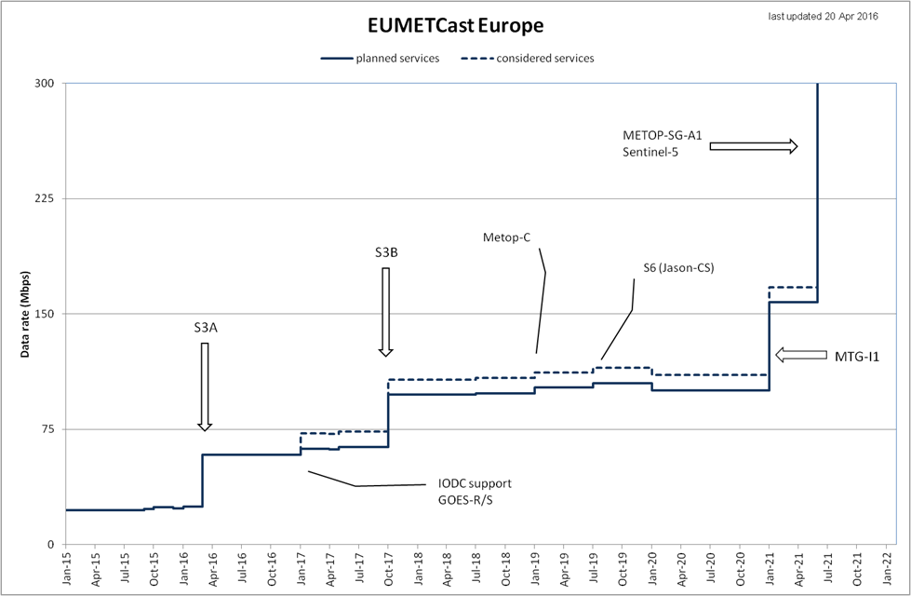
Evolution of EUMETCast – Data Rates
Out of date to be updated (KP)

Slide 36
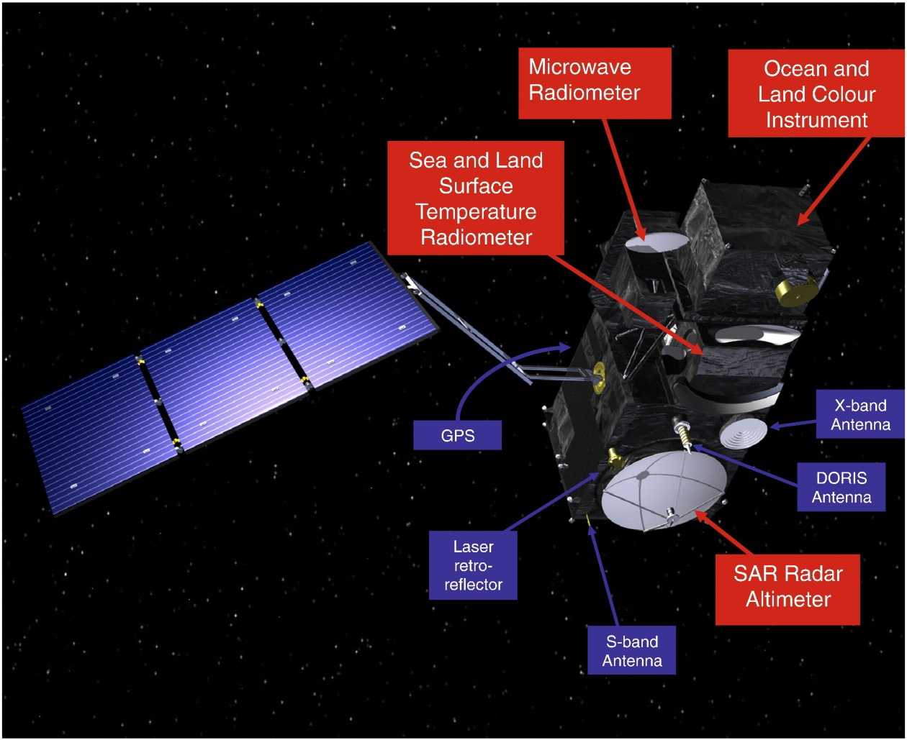
Data Access and Dissemination for Sentinel-3

Slide 37
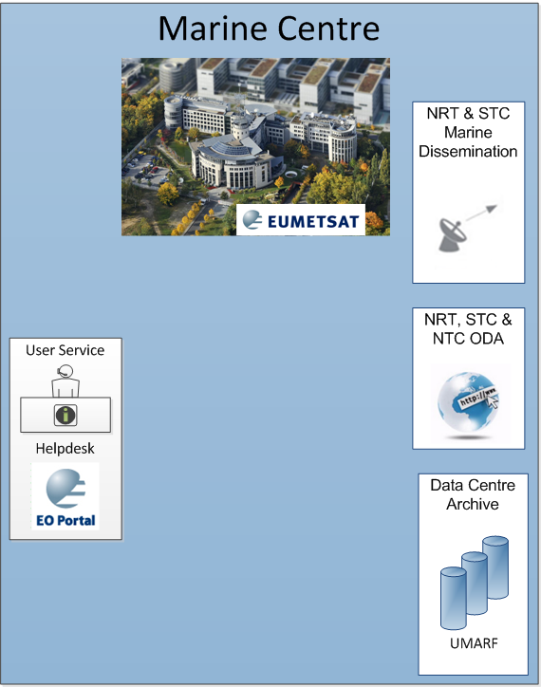
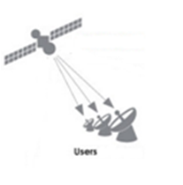
Data Access and Dissemination for Sentinel-3
EUMETCast
Traditional method of disseminating NRT data in EUMETSAT. Can involve satellite and terrestrial methods
Online Data Access (ODA)
Rolling archive of 12 month of data supporting ftp/http access
EUMETSAT Data Centre
Complete historical archive of all EUMETSAT data including S-3 marine data

Slide 38
Sentinel 3A Data Rates
 |  |  |  |  |  |  |  |  | EUMETCast Satellite (NRT/STC only) |  |  | ODA and Data Centre (NRT/STC/NTC)
Figures based on PDGS System Technical Budget 3.5 | Data volumes |  |  |  |  |  |  |  | Current assumption | S3A Only (S3B idem) |  | S3A Only (S3B idem)
Product type | uncompressed [GB/orbit] | Compression factor | compressed [GB/orbit] | User / Internal | NRT | STC | NTC | Mbps | (yes/no) | GB/orbit | Mbps | Disseminate via ODA (yes/no) | GB/orbit | Mbps
OL_1_EFR___ | 28.55 | 1.33 | 21.47 | User | X |  | X | 29.02 | yes | 21.47 | 29.02 | yes | 42.93 | 58.03
OL_1_ERR___ | 1.86 | 1.33 | 1.40 | User | X |  | X | 1.89 | yes | 1.40 | 1.89 | yes | 2.80 | 3.78
OL_2_WFR___ | 28.37 | 2.00 | 14.18 | User | X |  | X | 19.17 | no | 0.00 | 0.00 | yes | 28.37 | 38.35
OL_2_WRR___ | 1.89 | 2.00 | 0.95 | User | X |  | X | 1.28 | yes | 0.95 | 1.28 | yes | 1.89 | 2.56
SL_1_RBT___ | 69.50 | 2.40 | 28.96 | User | X |  | X | 39.14 | no | 0.00 | 0.00 | yes | 57.91 | 78.29
SL_2_WST___ | 2.24 | 3.00 | 0.75 | User | X |  | X | 1.01 | yes | 0.75 | 1.01 | yes | 1.49 | 2.01
FRP | 0.35 | 1.00 | 0.35 | User | X |  | X | 0.48 | yes | 0.35 | 0.48 | yes | 0.70 | 0.95
AOD | 0.06 | 1.00 | 0.06 | User | X |  | X | 0.08 | yes | 0.06 | 0.08 | yes | 0.12 | 0.16
SR_1_SRA___ | 0.42 | 1.00 | 0.42 | User | X | X | X | 0.57 | yes | 0.84 | 1.14 | yes | 1.26 | 1.70
SR_1_A___ | 8.30 | 1.00 | 8.30 | User |  | X | X | 11.22 | no | 0.00 | 0.00 | yes | 16.60 | 22.44
SR_1_BS___ | 8.30 | 1.00 | 8.30 | User |  | X | X | 11.22 | no | 0.00 | 0.00 | yes | 16.60 | 22.44
SR_2_WAT___ | 0.20 | 1.00 | 0.20 | User | X | X | X | 0.26 | yes | 0.39 | 0.53 | yes | 0.59 | 0.79
total | 150.03 |  | 85.32 |  |  |  |  | 115.34 |  |  | 35.41 |  |  | 231.51
Notes:
It looks like actual data volumes will be smaller.

Slide 39
EUMETCast Reception Station architecture
EKU
TCP/IP stack
DVB
NIC
router
Tellicast
client
file
DVB
database
card
Key to symbols
Disk access
Multicast, UDP
Samba
Log events
logs
received data
processed data
server
FTP data transfer
File fragments
USB transfers
Data
L
-
band RF
Logfile processing
Data processing
Data dispatch
transfers
Data to external nodes
RAM or RAMdisk
Hard disk partition
NIC
Software process
Log messages
Log events transfer
Network/DVB card
Reception station
(with driver, software)

Slide 40
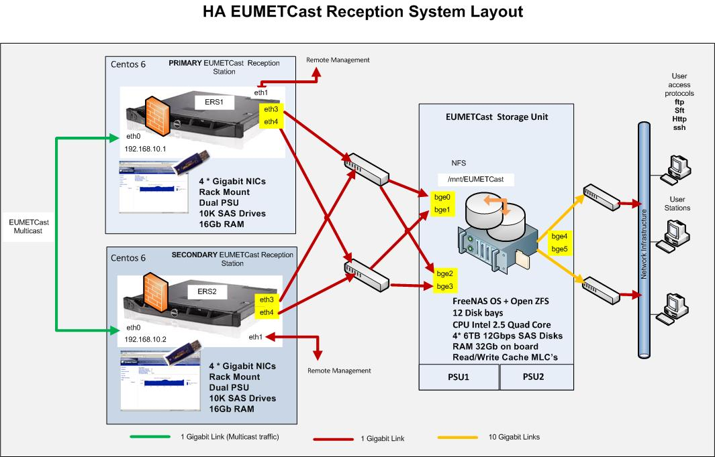
EUMETCast Reception Station – operational use

Slide 41
Reception Station Requirements
State of the art PC
X86 64bit CPU
64bit operating system (Linux, Windows)
4 GB RAM or larger
1GB network interfaces (for DVB router and LAN)
USB 2.0 (for EKU)
EKU Software
EUMETCast (Tellicast) client Version 2.12.1 or higher

Slide 42
Tellicast future developments
2.14 is currently undergoing testing
Java applet replaced by javascript/SVG
Memory leak of completed job fixed
More information in log files in verbose mode
On line help has been improved
Other small fixes leading to increased stability
Windows XP will no longer be supported
Notes:
Scalable Vector Graphics
2.14 rollout autumn
Windows XP can not support the HVS (needs 64bit). No longer supported by Microsoft

Slide 43
Reception capabilities
A properly designed reception PC is able to support all EUMETCast Services simultaneously
Stand alone reception stations are recommended (no virtual systems)
For operational use the station shall be in a redundant setup (see slide EUMETCast Stations for operational use)

Slide 44
More Information
Web site
http://www.eumetsat.int/website/home/Data/DataDelivery/EUMETCast/index.html
TD15: EUMETCast Technical Document
http://www.eumetsat.int/website/wcm/idc/idcplg?IdcService=GET_FILE&dDocName=PDF_TD15_EUMETCAST&RevisionSelectionMethod=LatestReleased&Rendition=Web
OICDs = Operational Interface Control doc,
interaction between external partner and EUMETSAT
EO Portal
http://www.eumetsat.int/website/home/Data/DataDelivery/DataRegistration/index.html
Product Navigator: Browse products available for all dissemination means
http://navigator.eumetsat.int/

